Slide 1


MAMA'S MEALS
Insight Explorers
PRESENT BY : -
Mahfooz Alam (12203001)
Nikita Kumari (12202879)
Muskan Pandey (12204867)
Anand Mailapalli (12209056)

Slide 2
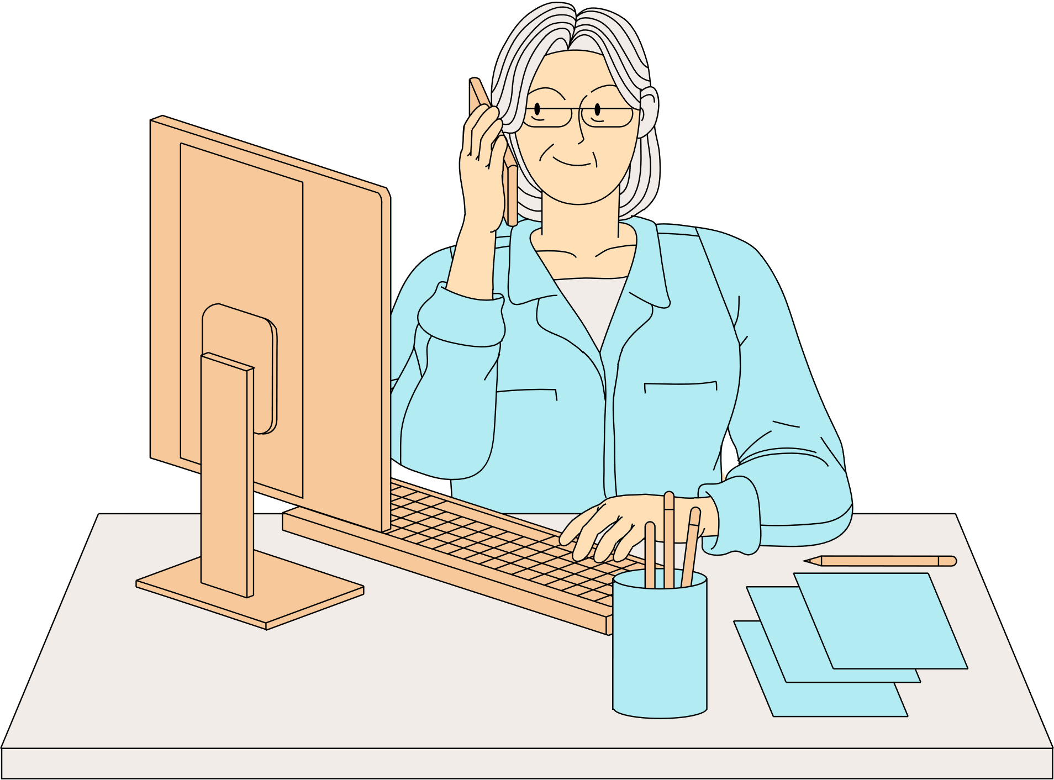
INTRODUCTION
Experience the comforting embrace of home-cooked meals crafted by nearby moms, catering to empowered students within a 3-4 km radius. This initiative not only satisfies hunger but also fosters community bonds, providing a taste of home that nourishes both body and soul in an increasingly fast-paced world."

Slide 3

DATA COLLECTING
We collect Data from Students and housewife's
through a google from with some relevant questionaries about food providing to student or get food from local mom’s to analyze Savor the comfort of home-cooked meals from nearby moms, bringing a taste of home within a 3-4 km radius for empowered students.

Slide 4
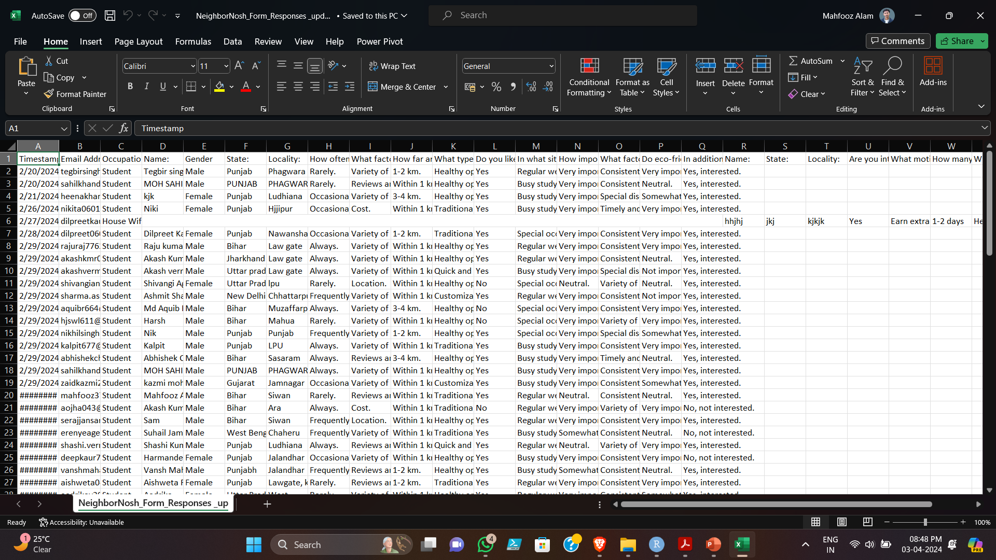

Slide 5
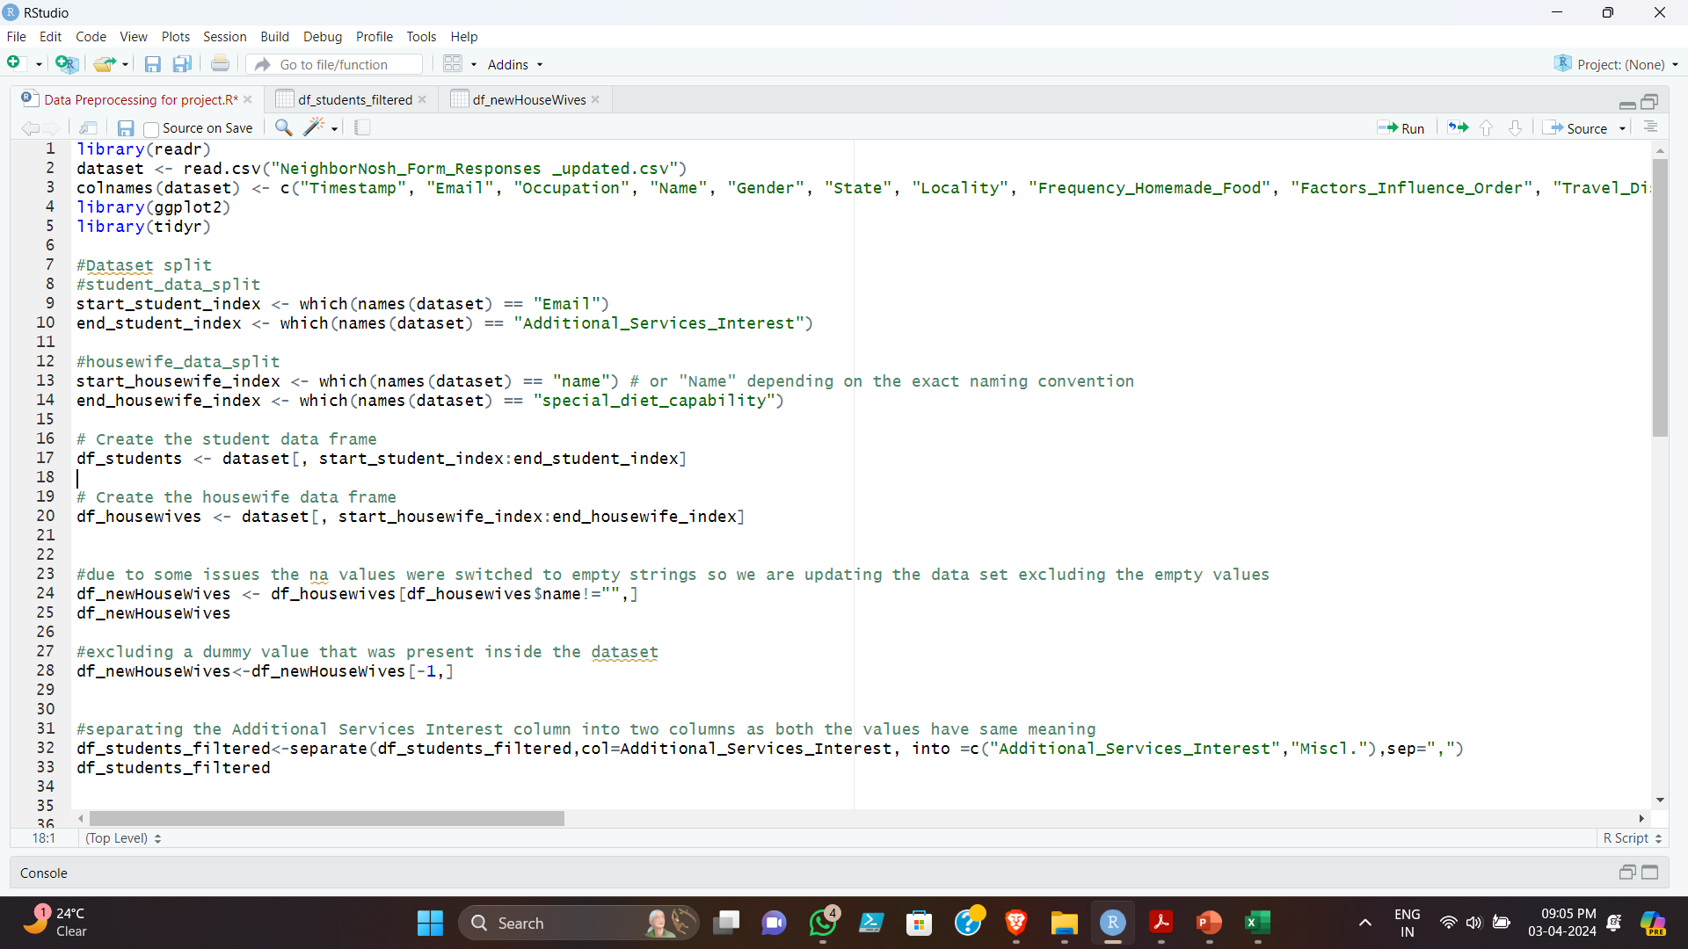

Slide 6
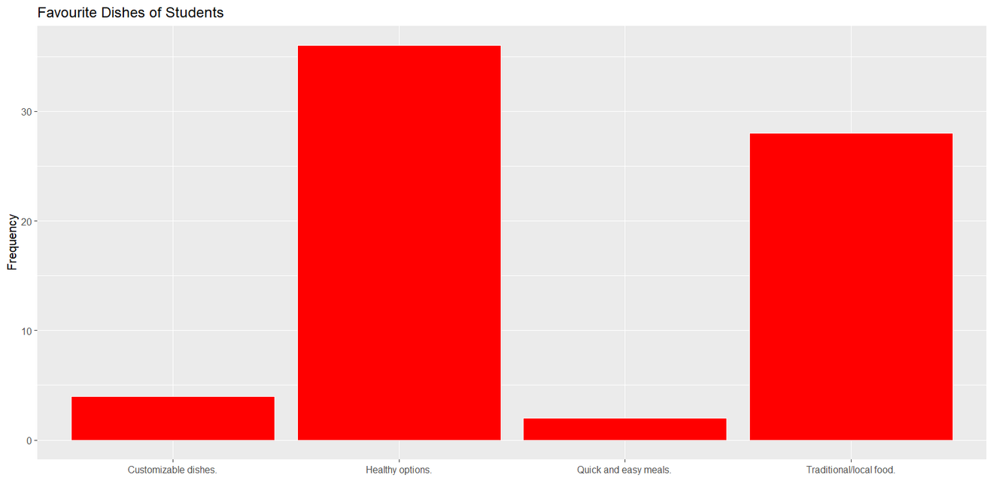
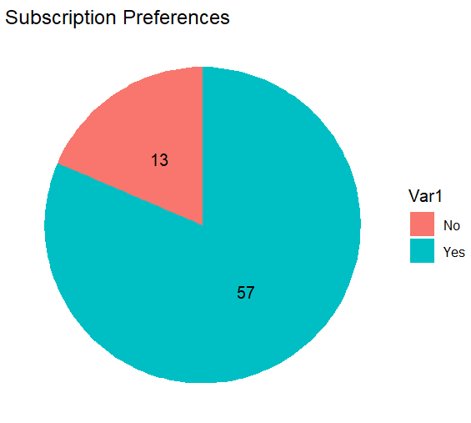
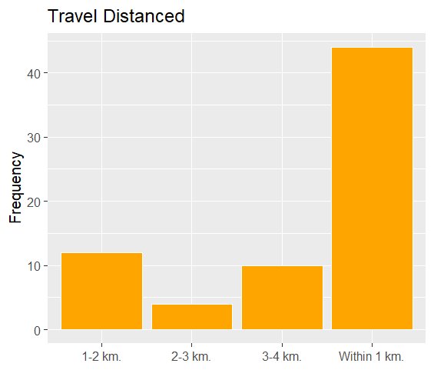
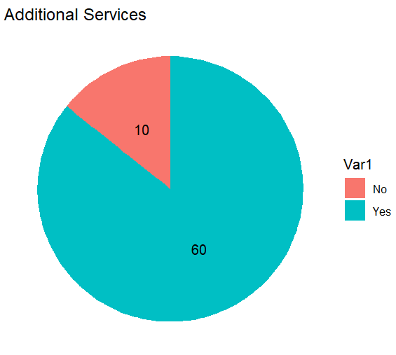
STUDENT DATA

Slide 7
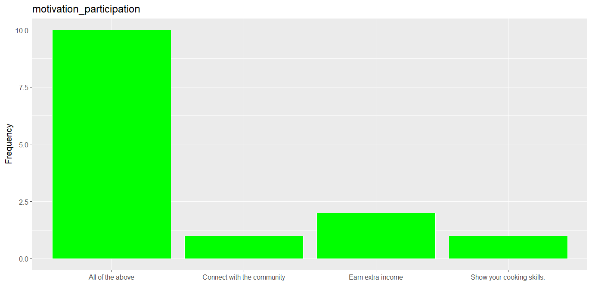
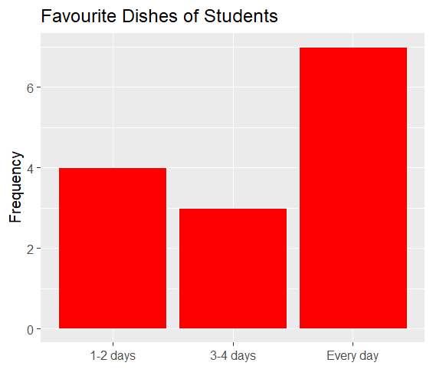
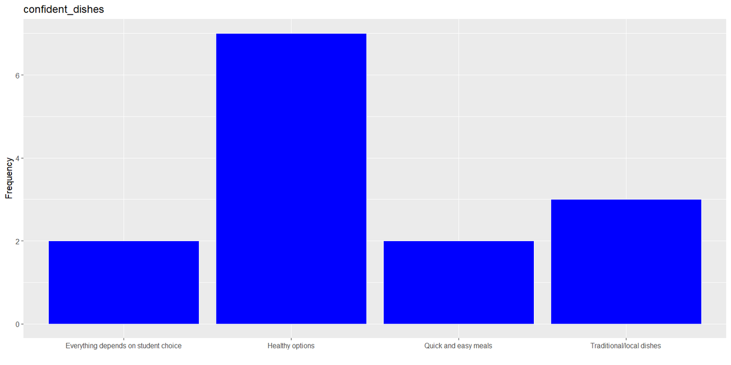
HOUSEWIFE’S
DATA

Slide 8
Conclusion
In conclusion, our analysis of student preferences and home-cooked meals reveals interesting insights into the connection between taste and familiarity. We found that [summarize key findings about student preferences, e.g., students tend to favour certain types of dishes or specific ingredients]. Interestingly, the housewife dataset demonstrated [summarize key findings about home-cooked meals, e.g., mothers often prioritize familiar dishes or cater to dietary needs]. This suggests a potential disconnect between what students crave and what they're typically served at home.

Slide 9

ARE THERE ANY QUESTIONS?
Thank You😊

